Slide 1

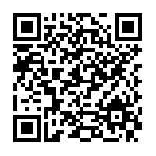
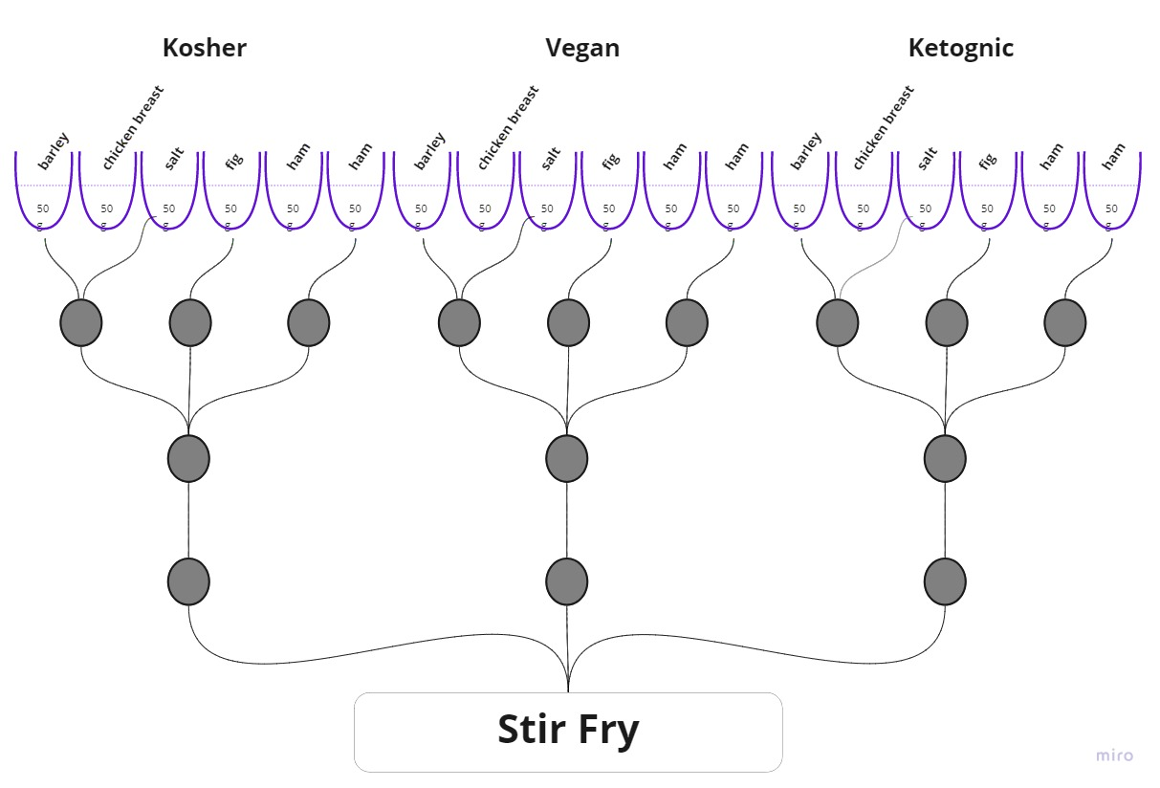
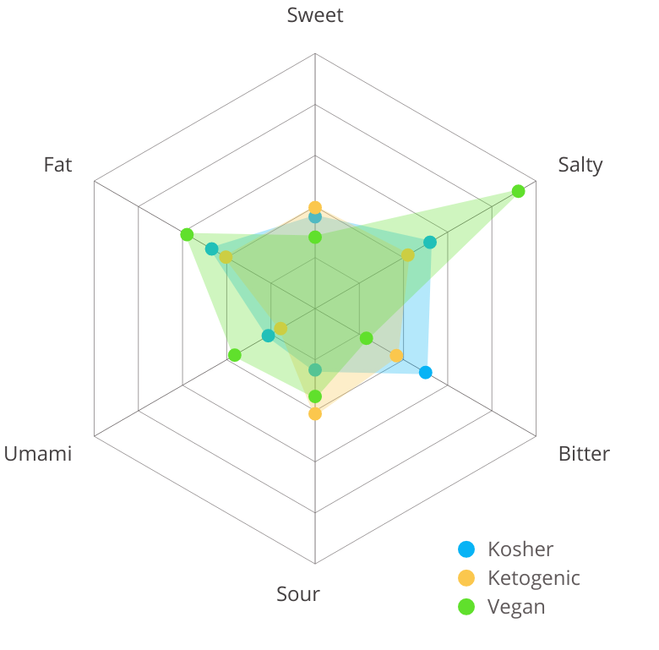
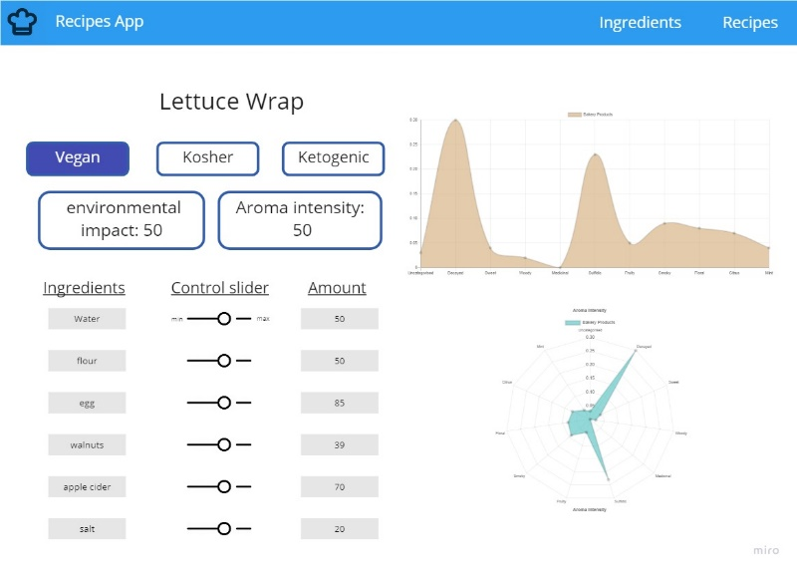
Digital Gastronomy Noam Domovich Shimon Heimowitz, Prof. Amit Zoran, Dr. Yossi Zaguri
Can a recipe be personalized by a digital agent?
IDEA
Create a Meta-recipe that could generate several different recipes
Stir Fry Taste Comparison
HOW
Create ingredient score, base on several categories
PRODUCT
Create your own recipe

